Slide 1
PBS -IIModex Familiarisation

Slide 2
Project Packages of PBS –II Modex unit
Package | 011-01-A | 011-01-B | 011-01-C | 12
Installation | 3 Boilers and its auxiliaries. STB Building along with EOT crane | 25 MW STG, 4 MW BPTG, Cooling Tower, Pump House | 3X 225 M3 /Hr. DM water Plant | 3 STB`s and its auxiliaries.
Contractors Contract signing date | M/s Fujian Longking Corporation Ltd. and M/s Allied Engineering Services Pvt. Ltd. 24.03.12 | M/s Triveni Engineering and Industries Ltd.,Banglore 19.01.12 | M/s TechnoFab Engineering Ltd., New Delhi 25.02.12 | Bharat Heavy Electricals Ltd. 11.11.10

Slide 3
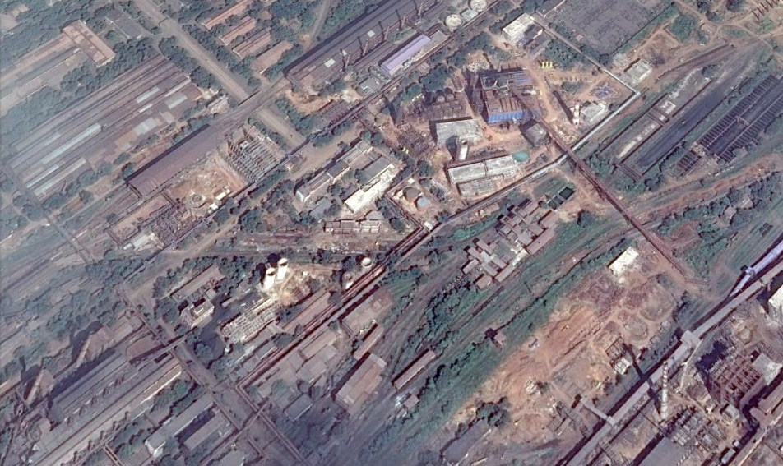
Site Map
N
3 STB
RCL
2 Boiler
DM water Plant
25MW STG
Pump House
Cooling Tower
1 Boiler
4 MW BPTG

Slide 4
Plant Requirement
Requirement | Emergency Power | Air Blast | Process Steam
Facility | STG (25MW), BPTG (4MW) | STB | Boiler(150TPH) , BPTG (4MW)
Customer | Critical Loads of Plant | Blast Furnace - 8 | Plant Steam

Slide 5
Boiler
3 Boilers – 2 in New PBS site and 1 in existing PBS.
Natural circulation, single drum, water tube, balanced draft, radiant type.
Capacity 150 TPH of each boiler.
Steam pressure at super heater outlet 40 ata.
Temperature of steam at outlet is 450ºC (+3/-2).
Fuel
Main: BF and BOF gas mixture.
Startup: LDO/CO gas.

Slide 6
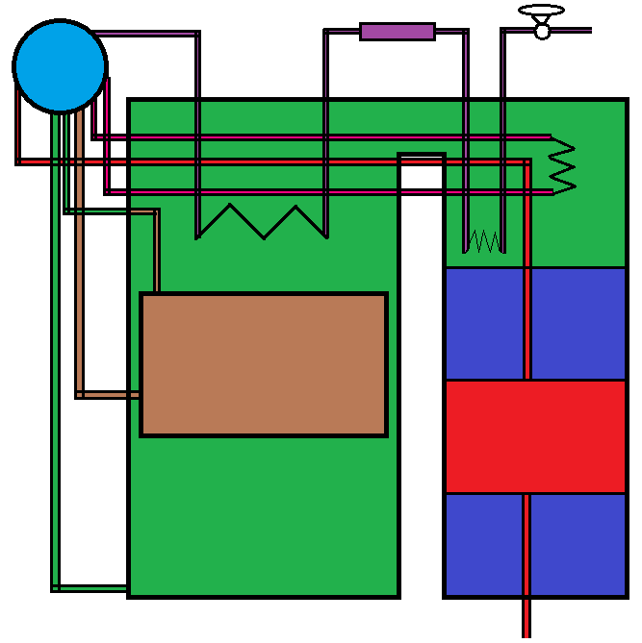
Boiler Drum
De super heater
To steam header
Evaporator
Top header
High temperature super heater
Low temperature super heater
Down comer
Upper air preheater
Center water wall
Economiser
Gas and Oil Burner
Water wall
Lower air preheater
Bottom header
From Boiler feed pump

Slide 7
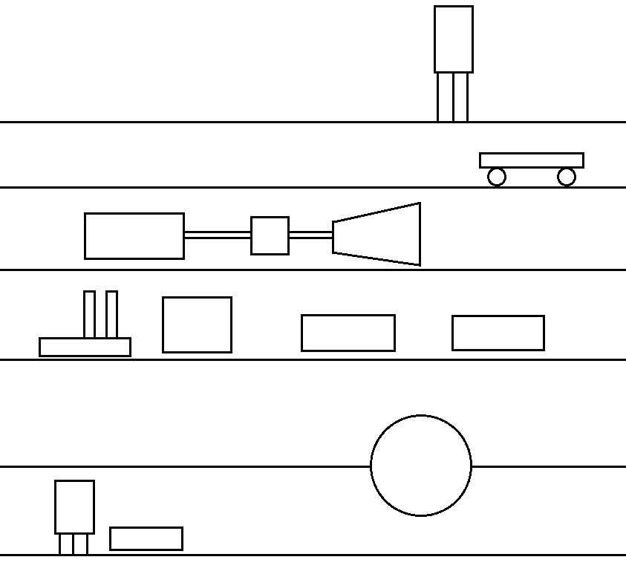
STG 25MW – AB Bay Front View
Level
Overhead Oil Tank
22 m
Overhead Crane
17 m
Gear Box
25 MW Generator
Steam turbine
11 m
Ejector Air pump
Gland Vent Condenser
7 m
Lube Oil Cooler
MOT
And Lube Oil circulation system
Condenser
3 m
Reserve oil tank
Centrifugal pump
0 m

Slide 8
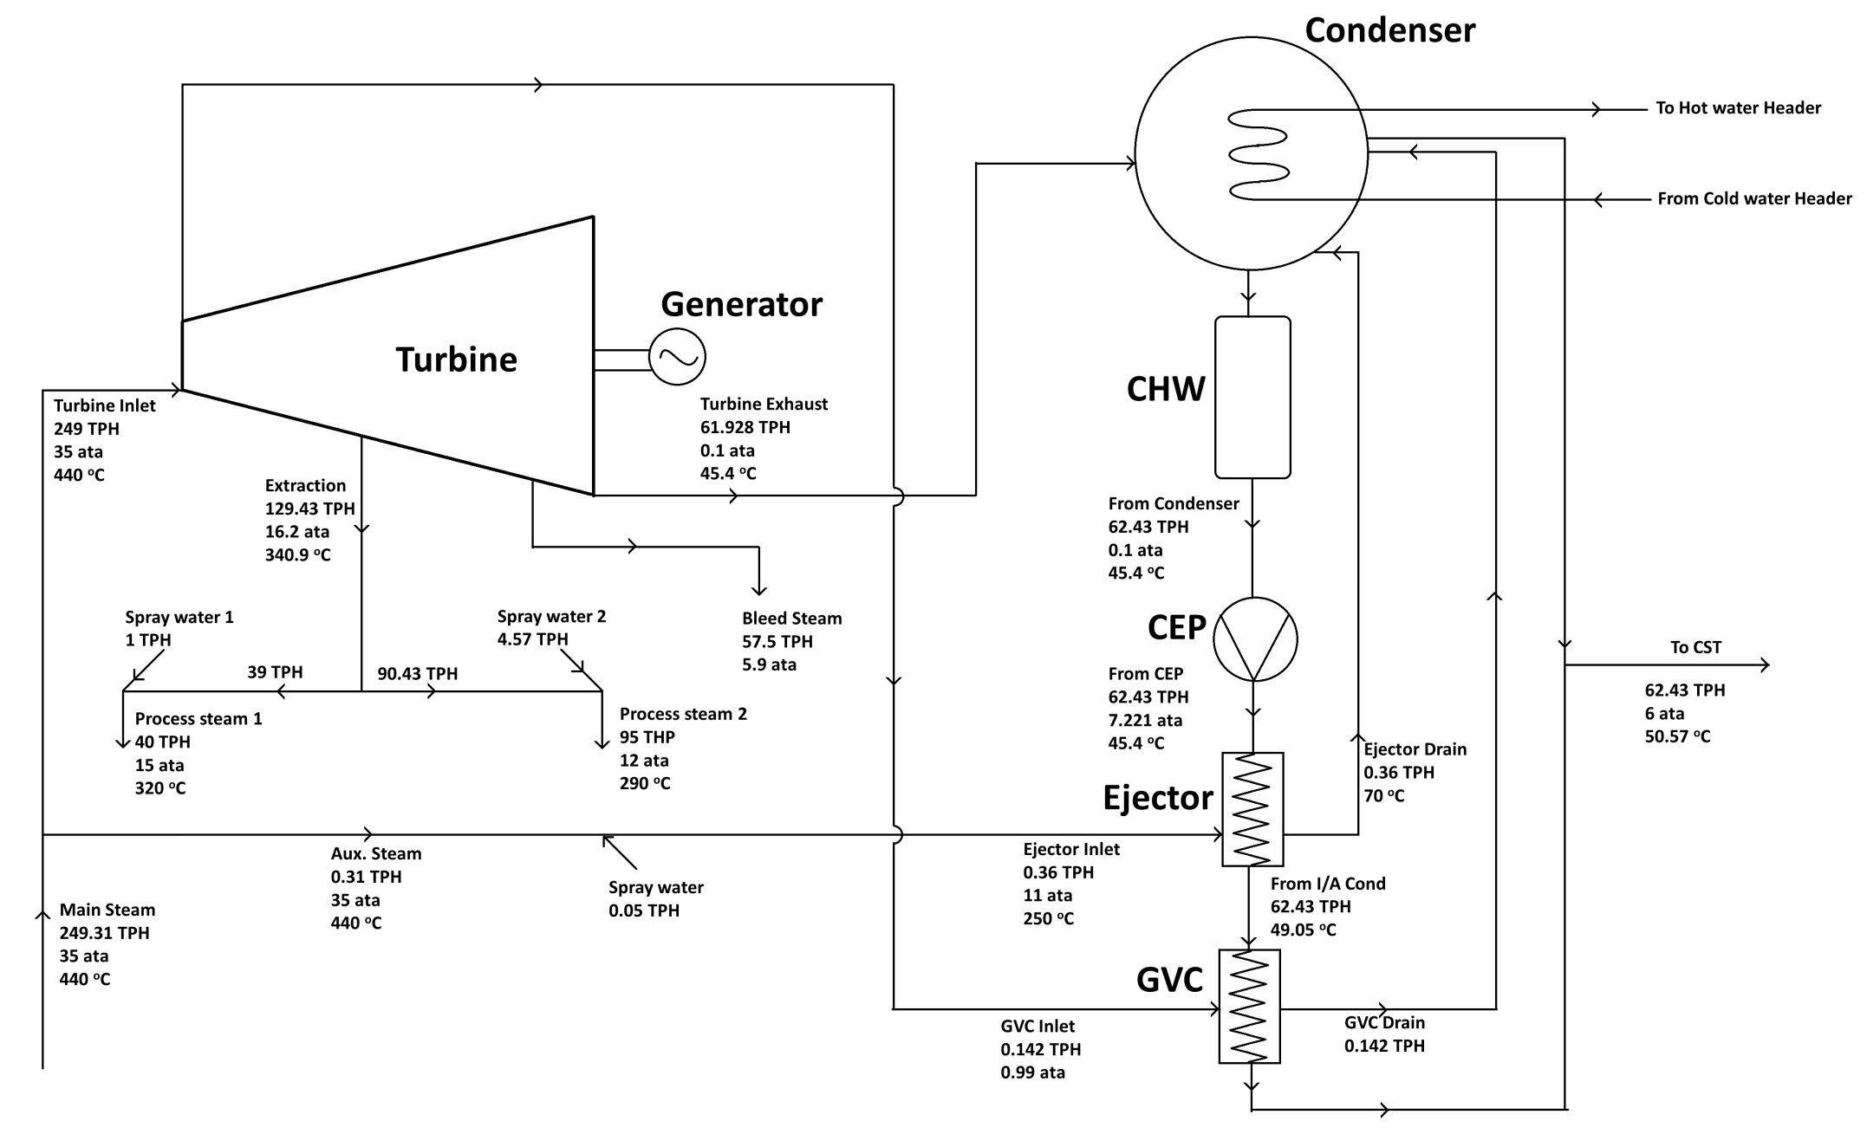
STG 25MW Process Flow

Slide 9
STG Mechanical Equipment
Equipment | Specification
Main Oil Tank | Fluid – ISO-VG-46 RDL Volume – 16875 lit Design Pressure – Atmospheric
Lube Oil Cooler | Shell side Oil flow 1400LPM 100ºC 15 kg/cm² G Heat Transfer rate |  |  | Tube side Water flow 3000LPM 100ºC 7 kg/cm² G 638 kW
Oil Circulation System | Lube oil capacity 1150LPM@2.3kg/cm² | Emergency oil capacity 400LPM@3kg/cm² |  |  | Control oil capacity 200LPM@12kg/cm² |  | Jacking oil capacity 7LPM@200kg/cm²
 | Heat transfer capacity |  |  |  | 638KW
Turbine | Power Inlet steam temperature Inlet steam pressure Exhaust pressure Extraction steam pressure Turbine rotor speed |  | Extraction mode 25000KW 440ºC 35kg/cm² 0.1kg/cm² 15kg/cm² 5625RPM |  |  | Standard condition 25000KW 440ºC 35kg/cm² 0.1kg/cm² - 5625RPM
Gear box | Rated power 26035KW Input /output speed 5661/1500 Ratio: 3.774
Ac generator | Output 31250KVA No. of phases 3 No. of poles 4 Voltage 11000 V Current 1640amp Speed 1500 RPM Limiting speed 1800RPM Power factor 0.8

Slide 10
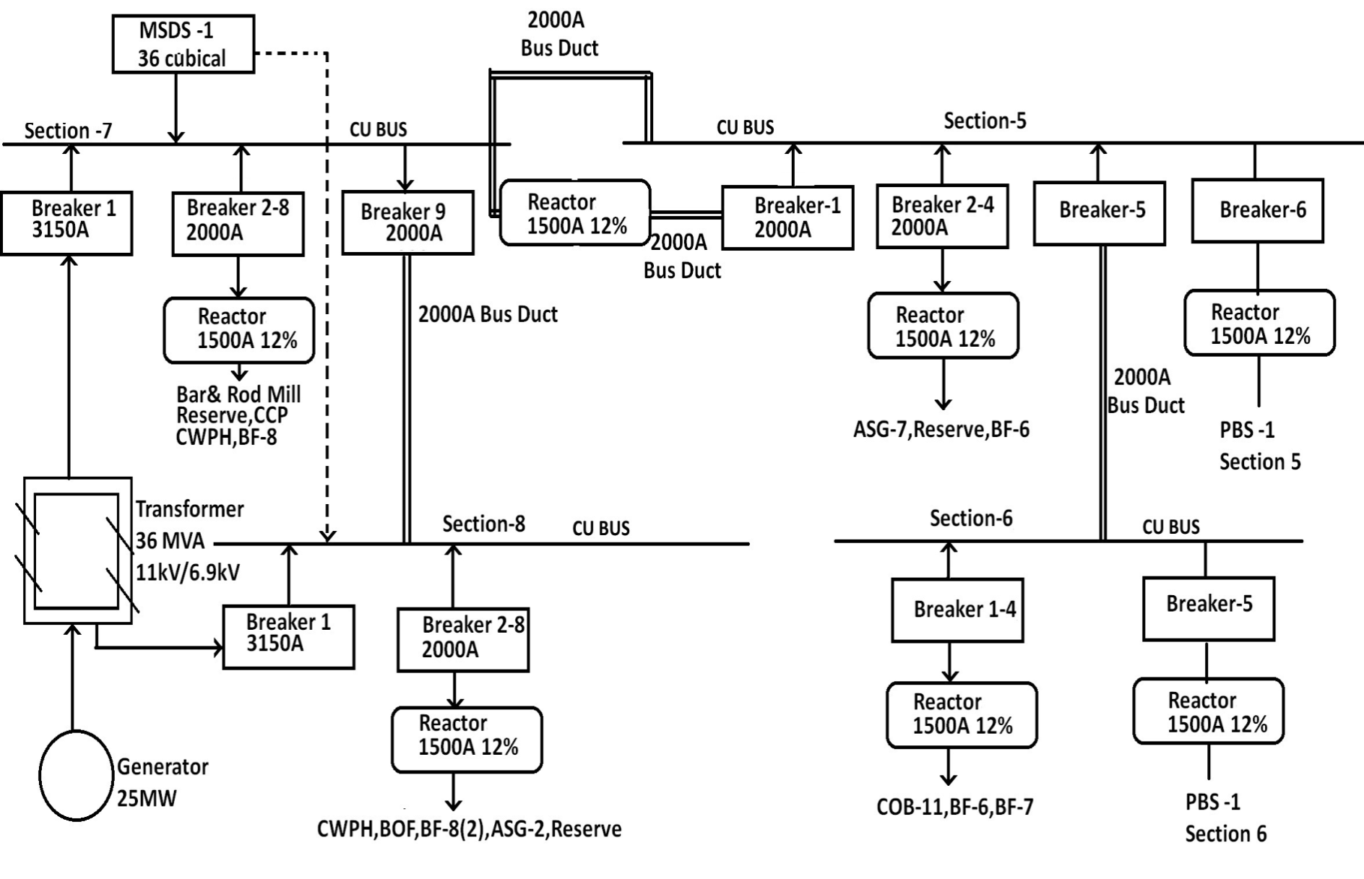
STG 25MW Electrical

Slide 11
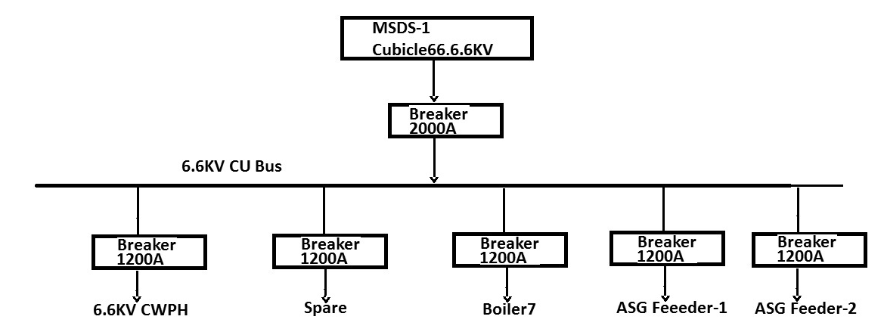
STG – Electrical
Reserve Supply Switch Board

Slide 12
STG Electrical Equipment
Equipment | Specification | Location
Transformer | 36MVA 11kV/6.9kV | 0 meters B-C
Breakers | 1. 3150 Amp 2. 2000 Amp | 11 meters A-B
Reactor | 1500 Amp, 12% | 3 meters A-B
DCS |  | 11 meters
LT Panels |  | 11 meters

Slide 13
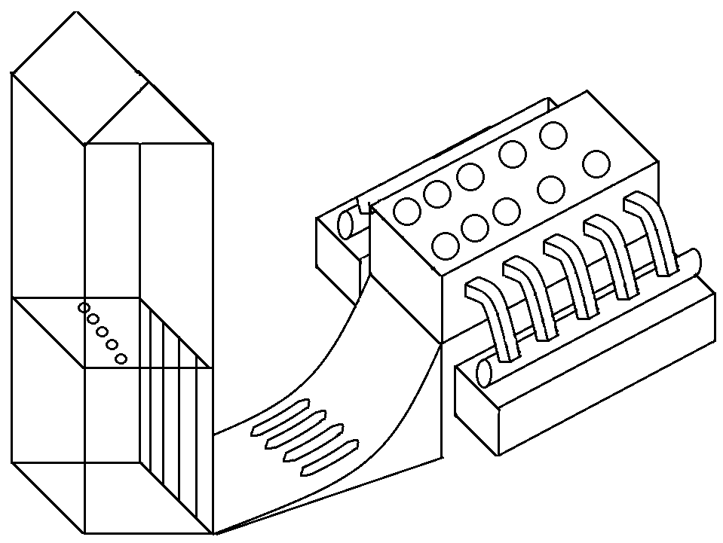
Cooling Tower and Pump House
Pump House
Cooling tower
Cell of Cooling tower
Hot water header from condenser
Vertical Axial water pump
Cold water channel
Sluice gates
Baffles

Slide 14
Cooling Tower and Pump House
10 cooling cells with 9 working and 1 standby.
Temperature reduces from 42ºC to 34ºC at supplied to STG and STB condenser.
Cooling Capacity is 19655 m³/hr.
5 Vertical axial flow pumps with 3 working and 2 standby.
Water sump in pump house has 8.5 m deep.

Slide 15
STB Mechanical Equipment
Equipment | Quantity | Level from Ground
Condenser | 3 | 0 m
Collecting Oil Tank | 3 | 0 m
Transfer Oil Pump | 3 | 0 m
Oil Centrifuge | 3 | 0 m
Transmitted Rack | 3 | 0 m
Lube Oil Tank | 3 | 4.5 m
Pump Skit Assembly | 3 | 4.5 m
Oil Cooler | 3 | 4.5 m
Oil Filter | 3 | 4.5 m
Jacking Oil Pump | 3 | 4.5 m
Control Oil Pump | 3 | 4.5 m
Steam Jet Air Ejector | 3 | 4.5 m
Gland Steam Condenser | 3 | 4.5 m
Governing Oil Console | 3 | 9 m
Main Oil Pump | 3 | 9 m
Common Lube Oil Storage Tank | 1 | 9m
Accumulator | 3 | 9m
TurboBlowers | 3 | 9m
Over Head Tank | 3 | 14.5 m

Slide 16
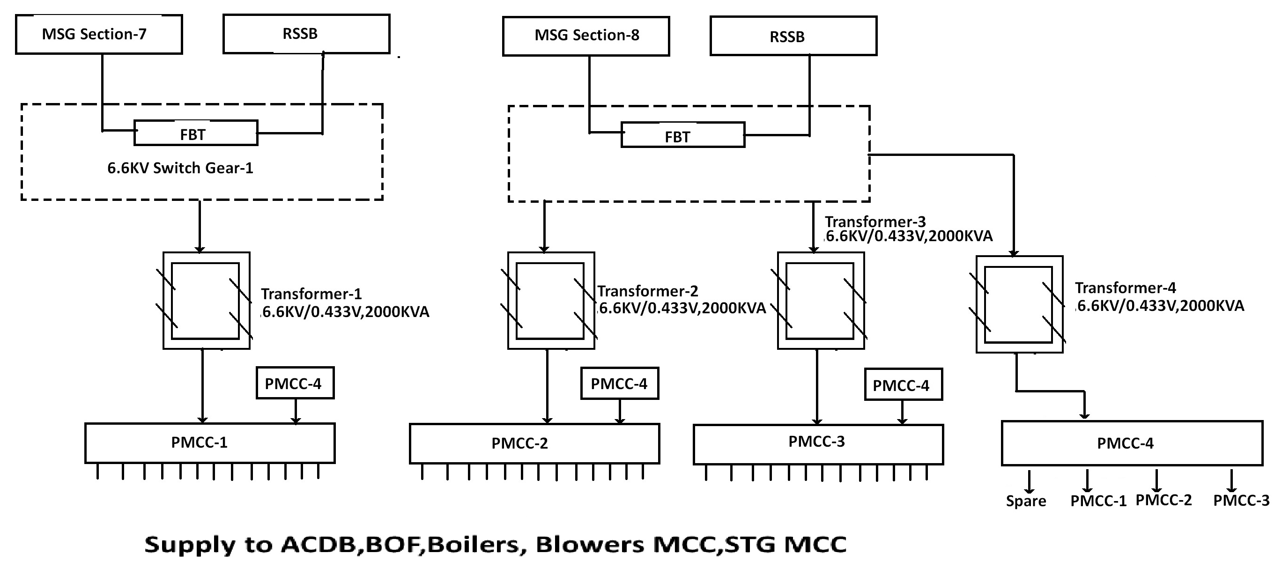
STB- Electrical

Slide 17
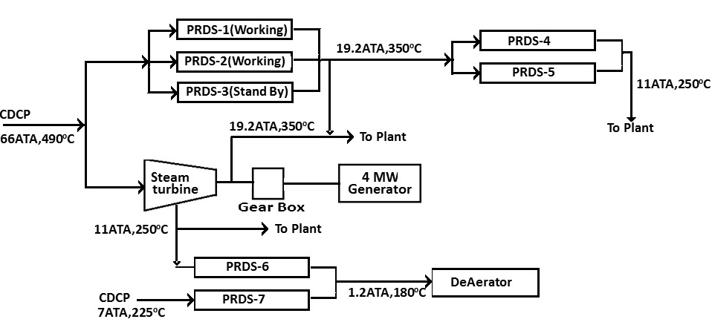
Flow Diagram of Steam in BPTG

Slide 18
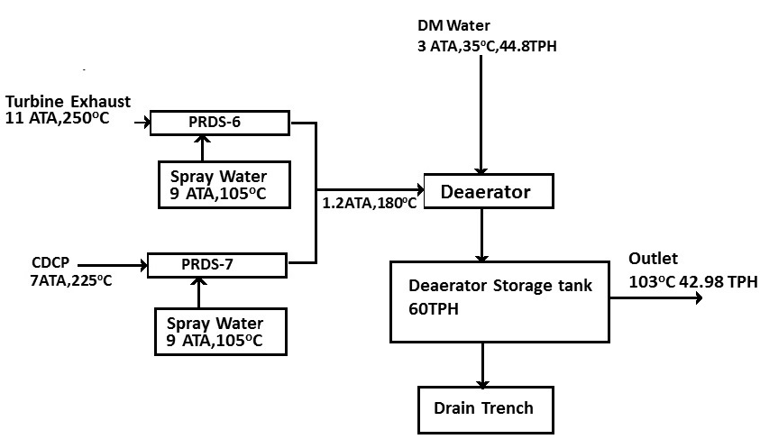
Deaerator in BPTG

Slide 19
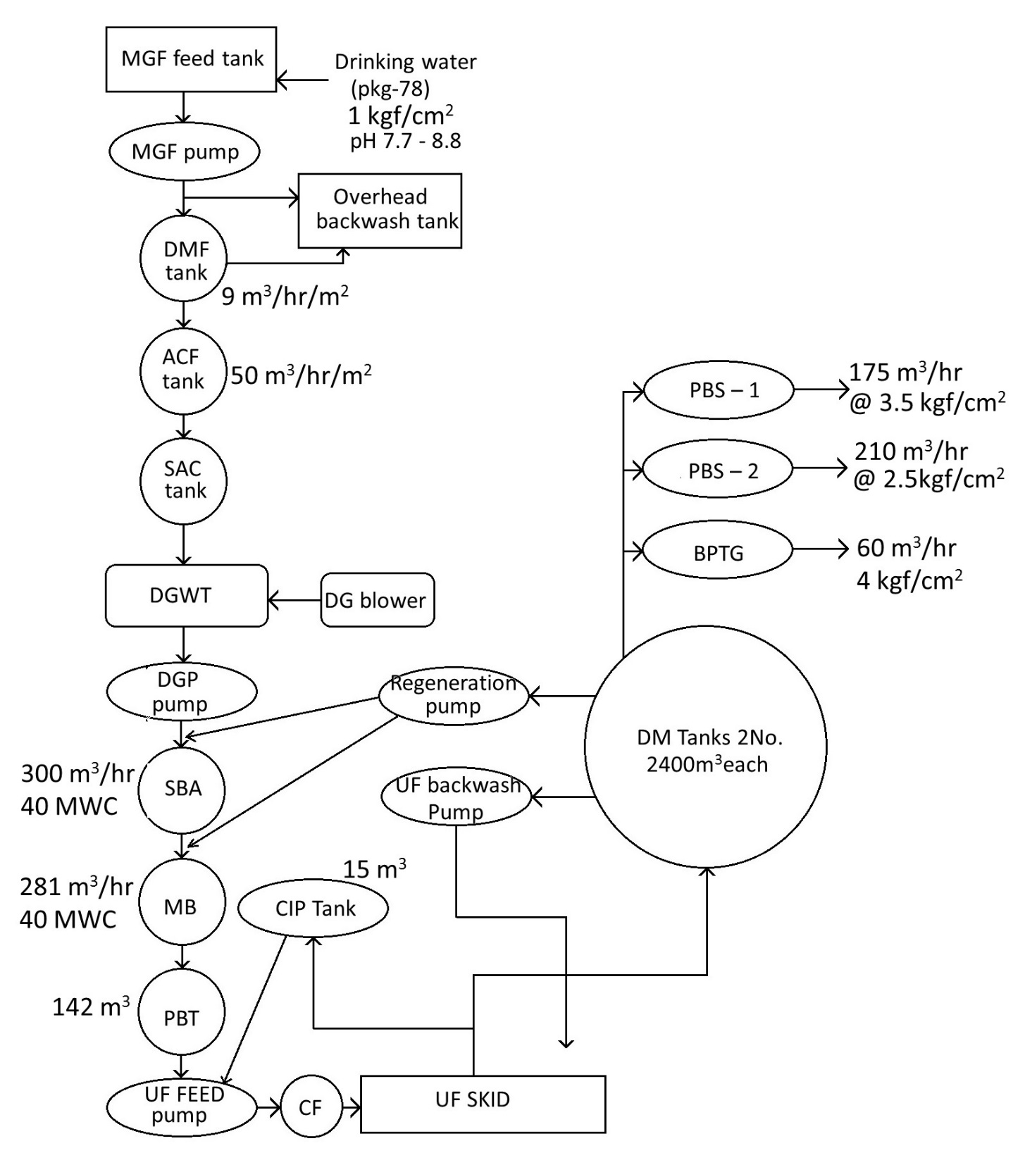
DM water plant Process flow chart

Slide 20
Plant capacity
1 | No. of streams | 03 Nos(2W+1R)
2 | No of operating streams | 01
3 | Net capacity of each stream | 225 m³/hr
4 | Running cycle for each stream | 20 hrs
5 | Regeneration cycle time | 4 hrs

Slide 21
Average water quality report of maroda-ii
Sl. No. | parameters | unit | values
1 | Physical analysis
 | Temperature | ºC | 20.5-30.0
 | Turbidity | NTU | 5
 | pH value | ₋ | 7.7-8.8
2 | solids
 | Total solids | mg/l | 70-100
 | Dissolved solid | mg/l | 66-94
 | Suspended solid | mg/l | 4-6
3 | Chemical analysis
 | As CaCO₃ | mg/l | -
 | Total hardness | mg/l | 42-62
 | Ca hardness | mg/l | 30-42
 | Mg hardness | mg/l | 12-20
 | M Alkalinity | mg/l | 50-70
 | P Alkalinity | mg/l | 0-5
 | chloride | mg/l | 3-5
 | Iron | mg/l | Nil
 | NH₃ |  | 0.1-0.4
 | Ca⁺⁺ |  | 12.0-16.8
4 | Special test
 | O.C.P | mg/l | 0.2-1.0
 | Oil and Grease | mg/l | -
 | I.L | mg/l | -0.6-+0.4
5 | B.O.D at 37ºC | mg/l | 0.7-2.1

Slide 22
Stage wise treated water quality
Sl. No. | Description | Parameters | Values
1 | After ACF | Turbidity | <2 ppm
2 | After cation exchanger | pH | 3-4
 |  | Total cations | Not > 2 ppm as CaCO₃
3 | After degasser | Free CO₂ | <5 ppm as CaCO₃
4 | After anion exchanger | pH | 7.5-9
 |  | TDS | <2mg/l
 |  | Conductivity | <10 micromho/cm at 20ºC
 |  | SiO₂ | <.2ppm as SiO₂
5 | After mixed bed units | pH | 6.8-7.2
 |  | conductivity | <.2 micromho/cm at 25ºC
 |  | Silica as SiO₂ | <.02 ppm
 |  | Fe | <.01 ppm
 |  | Hardness | Nil
 |  | Turbidity | Nil
6 | After Ultrafiltration | Silica | Nil
(i) |  | Reactive Silica | Limited to .02 ppm as SiO₂
(ii) |  | Colloidal silica | Shall be brought down to 98 % of feed water level

Slide 23
Regeneration flows for SAC
Sr.No. | Step | Flow(m³/hr) | Time(m) | Waste water (m³) | Type of water
1 | Back wash | 72 | 10 | 12 | FW
2 | Middle collector wash | 72 | 5 | 6 | FW
3 | Acid pre injection | 45.8 | 2 | 1.5 | DG
4 | Alkali injection
 | @ 1.2% | 46 | 15 | 11.4 | DG
 | @ 3% | 46 | 18 | 13.4 | DG
5 | Down flow
 | Step 1 | 46 | 15 | 11.5 | FW
 | Step 2 | 46 | 18 | 13.8 | FW
6 | Slow rinse | 45.3 | 37 | 27.9 | DG
7 | Down flow | 45.3 | 37 | 27.9 | FW
8 | Final rinse | 281 | 6 | 28.1 | FW

Slide 24
Regeneration flows for SBA
Sr.No. | Step | Flow(m³/hr) | Time(m) | Waste water (m³) | Type of water
1 | Back wash | 35 | 10 | 5.8 | DG
2 | Middle collector wash | 35 | 5 | 2.9 | DG
3 | Alkali pre injection | 10.6 | 2 | 0.4 | DM
4 | Alkali injection @ 3% | 12.2 | 30 | 5.9 | DM
5 | Slow rinse | 10.6 | 53 | 9.4 | DM
6 | Down flow | 12.2 | 83 | 16.9 | DG
7 | Final rinse | 281 | 4 | 18.7 | DG

Slide 25
Regeneration flows for mixed bed
Sr.No. | Step | Flow(m³/hr) | Time(m) | Waste water (m³) | Type of water
1 | Back wash | 44 | 10 | 7.3 | SBA
2 | Middle collector wash | 44 | 2 | 1.5 | SBA
3 | Alkali pre injection | 11.1 | 2 | 0.4 | DM
4 | Alkali injection @ 4% NaOH | 13.2 | 20 | 4.2 | DM
5 | Slow rinse | 11.1 | 34 | 6.3 | DM
6 | Up flow | 13.2 | 54 | 11.9 | SBA
7 | Acid pre injection | 17 | 2 | 0.6 | DM
8 | Acid injection @ 4% | 17.4 | 20 | 5.6 | DM
9 | Slow rinse | 17 | 23 | 6.5 | DM
10 | Down flow | 17 | 43 | 12.2 | SBA
11 | Drain down | - | 5 | - | -
12 | Air mix | 600 | 10 | - | -
13 | refil | - | 2 | 5 | SBA
14 | Final rinse | 277 | 7 | 32.3 | SBA

Slide 26
MASTER EQUIPMENTS LIST
DESCRIPTION | MOC | QUANTITY
Feed Water Tank ( Capacity 580 M3/hr Dual Media Filter ( 4700 dia x 4914 ht) Active Carbon Filter ( 4900 dia x 5022 ht) Strong Acid Cation ( 3200 dia x 5130 ht) Degasser Tower ( 2400 dia x 2700 ht) Degassed Water Tank ( 4000 dia x 10460 ht) Strong Base Anion ( 3000 dia x 3180 ht) Mixed Bed ( 2500 dia x 3876 ht) Pressure Break Tank ( 5000 dia x 8000 ht) Cartige Filters for UF Feed ( Flow 300 m3/hr x Pr 6 Kg/cm2) UF Skids DM Water Tank ( Capacity : 2400 M3 ) | RCC MS, EPOXY PAINTED MS, EPOXY PAINTED MSRL MSRL MSRL MSRL MSRL SS PVDF MEMBRANE MSRL | 1 2W + 1S/D 2W + 1S/D 2W + 1S/D 2W + 1S/D 2W + 1S/D 2W + 1S/D 2W + 1S/D 2W + 1S/D 2W + 1 S/D 2W + 1S/D 2

